Slide 1
The 2019 Novel Coronavirus
With Staff of the
Boston Public Health Commission

Slide 2
Learning Objectives
To understand what is the 2019 Novel Coronavirus
To understand how it spreads and who is at risk
To identify best practices for prevention and wellness
To identify strategies for interrupting racial bias
Notes:
Changed 4th learning objective
Best Practies for prevention of spread and wellness both physically and mentally

Slide 3
What is the 2019 Novel Coronavirus (COVID-19)?
A new strain of coronavirus
First detected in Wuhan, China and has spread to 141 countries worldwide
Coronaviruses (CoV) are a large family of viruses that cause illness ranging from the common cold to more severe diseases
Middle East Respiratory Syndrome (MERS-CoV) and Severe Acute Respiratory Syndrome (SARS-CoV) are examples of coronaviruses
Notes:
Added spread to 141 other countries as of today

Slide 4
Global Cases for COVID-19

Slide 5
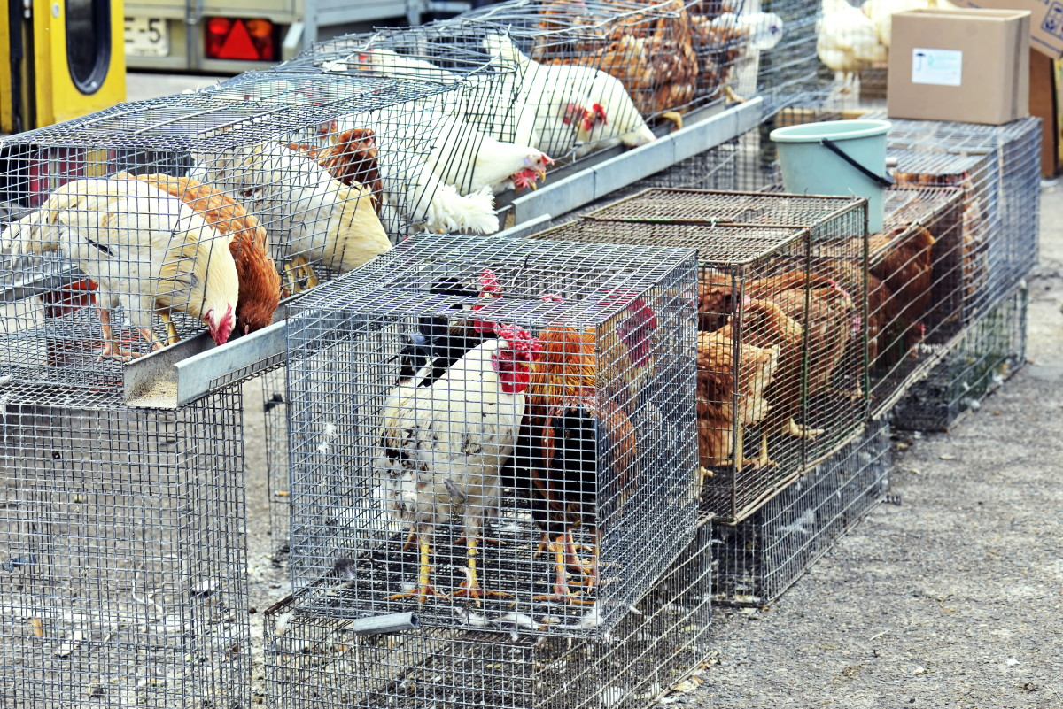
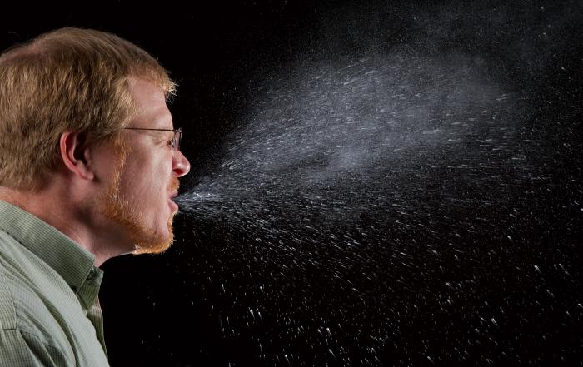
How does COVID-19 spread?
Animal-to-people
Person-to-person
Close contacts (about 6 feet)
When an infected person coughs or sneezes
Touching contaminated surfaces or objects
Notes:
Person to person is considered the primarily mode of transmission

Slide 6
Symptoms can appear between 2-14 days after exposure
Cough
Fever
Shortness of breath
Notes:
Symptoms of 2019-nCoV may be similar to the flu. Preliminary information suggests that older adults and people with underlying health conditions may be at increased risk for severe complications from this virus. Symptoms are

Slide 7
Individuals at High Risk for Complications
Older adults
People with chronic medical conditions like heart disease, diabetes, lung disease
Pregnant women

Slide 8
How can COVID-19 be prevented?
Wash hands often with soap and water for at least 20 seconds or use alcohol-based hand sanitizer
Avoid touching eyes, nose, and mouth with unwashed hands
Avoid the virus. Avoid close contact with people who are sick
Stay home when you are sick
Cover your cough or sneeze
Do not share drinks, food, or eating utensils
Clean and disinfect frequently touched objects and surfaces

Slide 9
Social Distancing
A public health practice that aims to prevent sick people from coming in close contact with healthy people.
People are asked to:
Remain out of congregate settings,
Avoid mass gatherings, and
Maintain physical distance (approx. 6 feet) from others.

Slide 10
Goals of Social Distancing
To reduce opportunities for disease transmission,
To reduce the chance of infection among high-risk populations, and
To reduce the burden on health care systems and workers.

Slide 11
Steps for Social Distancing
Schools, colleges, & universities have suspended in-person classes & converting to remote online instruction
Events, including sporting events, festivals & parades have been cancelled or postponed
Workplaces are encouraged to offer flexible work options, including telecommuting
Organizations and businesses are canceling large gatherings, including conferences
Houses of worship, community and recreational Centers have suspended services
Restaurants and eateries restricted to take out and Delivery only
Notes:
Added restaurants and bars

Slide 12
Who is at risk of acquiring COVID-19?
People who have recently traveled to areas with widespread or sustained Community Transmission
Close contacts of people diagnosed with COVID-19
Emergency Responders and other healthcare
professionals
Notes:
China, Iran, Italy, Japan, and South Korea are areas with widespread transmission as of February 28th, 2020
This seems a little outdated at this point?… We know there has been widespread community transmission so **Isn’t ANYONE/EVERYONE AT RISK OF ACQUIRING IT?

Slide 13
Who Should use Face Masks to protect against COVID-19?
Healthy individuals do not need to wear facemasks
People who may need to use facemasks include:
People with suspected or confirmed COVID-19 infection who have respiratory symptoms
Relatives or caregivers of people with suspected or confirmed COVID-19 infection
Healthcare workers entering a hospital room where people with suspected or confirmed COVID-19 are being treated
Notes:
Changed the wording of the question

Slide 14
What can travelers do to protect themselves and others?
The U.S. State Department issued a travel advisory recommending Americans reconsider travel abroad.
Many areas throughout the world are now experiencing COVID-19 outbreaks and taking action that may limit traveler mobility, including quarantines and border restrictions.
Even countries, jurisdictions, or areas where cases have not been reported may restrict travel without notice.

Slide 15
Talk to your Healthcare Provider if…
If you have symptoms consistent with COVID-19 virus and have traveled to an area with widespread transmission of COVID-19 in the past 14 days
If you experience symptoms and have been in contact with someone who has tested positive for COVID-19 infection in the past 14 days
Healthcare providers will get detailed travel and contact history from patients with fever and acute respiratory illness to determine if patient needs to be tested for COVID-19.

Slide 16
People suspected to have COVID-19 should…
Separate yourself from people and animals in your home
Call ahead before visiting your doctor so they can prepare for your arrival
Wear a face mask when around other people
Wash hands often with soap and water for at least 20 seconds.
Disinfect and sanitize high touch surfaces and objects frequently
Notes:
I updated this according to the current CDC recommendations for people suspected to have COVID 19

Slide 17
How is COVID-19 treated?
There is no specific antiviral treatment
People infected with COVID-19 should receive supportive care and help to relieve symptoms
People who think they may have been exposed to COVID-19 should consult with a medical provider right away

Slide 18
When to Stop Home Isolation
People diagnosed with COVID-19 will be assigned a Public Health Nurse who will help to monitor their health and determine when they can stop home isolation.
For people who suspect that they have COVID-19, and have chosen to self-isolate, CDC states you can stop home isolation if:
You have had no fever for at least 72 hours (without the use medicine that reduces fevers) AND
other symptoms have improved (i.e. cough or shortness of breath have improved) AND
at least 7 days have passed since your symptoms first appeared

Slide 19
3 Impacts of a Pandemic
Stigma, Xenophobia and Racism
Mental Health, Trauma and Addiction
Highest Burden on the “Most Vulnerable”
Notes:
Im going to walk through these next 3 things with a lens of Solidarity and Sensitivity as Elena Chang of the Theater Communications Group has so gracefully held out for us. The first thing to remember is that we are all in this together. There is no escaping that.

Slide 20
COVID-19 and Stigma
Centers for Disease Control
Some groups of people who may be experiencing stigma right now because of COVID-19 include:
Persons of Asian descent and those perceived as Asian
People who have recently traveled
Emergency responders or healthcare professionals
Stigma hurts everyone by creating fear or anger towards other people.
Stigmatized groups may be subjected to:
Social avoidance, bullying or rejection
Denials of healthcare, education, housing or employment
Physical and psychological violence
Notes:
Stigma occurs when people associate a risk with a specific people, place, or thing – like a minority population group – and there is no evidence that the risk is greater in that group than in the general population. Stigmatization is especially common in disease outbreaks.

Slide 21
Reduce Stigma with FACTS
COVID-19 doesn't recognize race, nationality, or ethnicity. Anyone, from anywhere, is susceptible to this virus.
COVID-19 started in Wuhan, China. That's just geography. Having Chinese ancestry-- or any other ancestry -- does not make a person more vulnerable to this illness.
Refer people to reputable, trusted sources:
www.cdc.gov
www.bphc.org
https://www.mass.gov/orgs/department-of-public-health
Notes:
Added MA DPH – couldn’t find a shorter link
Maintain privacy and confidentiality of those seeking healthcare and those who may be part of any contact investigation.
Quickly communicate the risk or lack of risk from associations with products, people, and places.
Raise awareness about COVID-19 without increasing fear.
Share accurate information about how the virus spreads.
Speak out against negative behaviors, including negative statements on social media about groups of people, or exclusion of people who pose no risk from regular activities. Make public posters that counteract bigotry and misinformation.
Be cautious about the images that are shared. Make sure they do not reinforce stereotypes.
Engage with stigmatized groups in person and through media channels including news media and social media.
Thank healthcare workers and responders. People who have traveled to areas where the COVID-19 outbreak is happening to help have performed a valuable service to everyone by helping make sure this disease does not spread further.
Share the need for social support for people who have returned from China , Iran, Italy or are worried about friends or relatives in the affected region.

Slide 22
COVID-19 and Racism or Xenophobia
“Global anxiety about the outbreak of the coronavirus has led to the spread of much misinformation and scapegoating. …we have seen a rise in incidents of bias, harassment, bullying, isolation, exclusion and xenophobia against Chinese people and those who are perceived as being Chinese.”
-Anti Defamation League
www. health.mn.gov
Notes:
Online workshops or training strategies – online community forums
Support theater administrators, be prepared to intervene
Number of online trainings on upstander trainer strategies,
Incidneces on the rise… highest in our government leadership using Chinese disease – the Kung Flu

Slide 23
Interrupt Speak Up
COVID-19 and Racism or Xenophobia
Speak up if you hear, see or read misinformation and Report harassment.
Gently correct false information and remind the person that prejudiced language and actions make us all less safe.
Create institutional policies that reflect anti-racist values and culture of belonging.
Notes:
Equipped with facts
Prepared to intervene
Cultivate culture of belonging

Slide 24
COVID-19 and Mental Health, Trauma and Addiction
Public health Crises like this exacerbate other health conditions
OCD, PTSD, Anxiety, Eating Disorders, Depression- worse symptoms/less help
Immune systems especially taxed; Cortisol levels high
In home Family/Caregiver supports suspended
Personal care providers for elderly, sick and hospice patients
State monitoring visits – increases in domestic violence, child abuse, neglect
Ongoing and Acute Care interrupted
In-person support groups for Addiction and Recovery
Substance Use Disorder Clinics are closed, Psychiatry/Therapy via phone
Notes:
Pandemics are traumatizing and trigger trauma for all of us
Whether we live anxiety or obsessive compulsive behaviors, we might be anxious, paranoid, etc.
Understand Triggers, Avoid blaming and shaming;

Slide 25
COVID-19 and the “Most Vulnerable”
Know who will be hurt/burdened the most
People of Color, People with Disabilities, hourly or tip wage staff, service workers, local shopkeepers, youth, elderly... our loved ones!
Observe, track, keep data now in order to advocate effectively for appropriate recovery resources later.
Remember that resource hoarding hurts our most vulnerable populations the most – Stock Up don’t Stockpile
Notes:
We call this “coded” language
More for some means less for others… this is a time for us to take care of one another and those that need
People who live check to check can only afford so many groceries a week. They cannot stock up. They can only purchase enough for that week at any given time. Shelves will be restocked. Don’t FEED the FEAR
What you should do, however, is make some preparations. That means having basic essentials on hand such as food, medicine, and cleaning supplies. Being prepared does not mean stockpiling or hoarding. While the CDC states that people should have sufficient quantities of household items and groceries in the event that they need to stay home "for a period of time," the U.S. Department of Homeland Security is recommending not more than two weeks' worth of supplies.
This is inherently about equity – Racial Justice is Economic Justice –There’s a whole Psychology around this – the real world crisis around panic buying and surge pricing… where some folks are spending $800 for a case of Purell and other folks don’t have essential items like TP, food, baby formula, diapers, and folks who can’t benefit from them have surgical masks and our health care providers and first responders don’t. The goverrnnent stockpiles – individuals need only to stock up
Stock up but do not Stock Pile – it takes a way form those who need it most – there is a real difference between panic buying and disaster preparation - we are exhibiting compulsive behaviors… experts say its because we have the need to do something – to feel a sense of control - Well 2 things we can do we can control every hour of every day - washing our hands and checking ourselves for racist and unjust behaviors.
And lastly – I want to make one note about the public health concept of social distancing… I’m a general semanticist. Words influence behavior. What we actually mean with this concept is PHYSICAL Distancing. This is important because We want you to stay socially connected- in solidarity and with sensitivity – for yourself and others. Be gentle, Have patience

Slide 26
Moving Forward – What can YOU (and MCC) do?
“With a lens of Solidarity and Sensitivity…”
-Elena Chang
We are in this together, my/your fate is our shared fate; Think I=WE
Raise awareness of less visible impacts on the most vulnerable members of our communities
Stay physically distant but socially connected! Spread love.
Notes:
With this lens in mind – what can the Arts Community do to contribute to the stability, health and wellness of your community during this time? How can you support one another
Stay connected, TALK with others via phone, text, direct message, social media, watch parties, zoom circles , google duo, skype, facetime, Or OLD SCHOOL – from the front stoop, through windows, across yards and streets
Encourage people to CREATE, sing, write, paint, sketch, build, repair, dream, plan, play. And Rest. Enjoy the down time. Be grateful
We can take care of ourselves and take care of others. That’s what we can do
And lastly – I want to make one note about the public health concept of social distancing… I’m a general semanticist. Words influence behavior. What we actually mean with this concept is PHYSICAL Distancing. This is important because We want you to stay socially connected- in solidarity and with sensitivity – for yourself and others. Be gentle, Have patience. Spread love

Slide 27
Questions?

Slide 28
Resources
www.bphc.org/2019ncov
https://www.cdc.gov/coronavirus/2019-ncov/index.html
https://www.cdc.gov/media/releases/2020/p0121-novel-coronavirus-travel-case.html
https://www.mass.gov/guides/information-on-the-outbreak-of-2019-novel-coronavirus-2019-ncov
https://massculturalcouncil.org/blog/an-update-to-our-response-to-covid-19/

